Slide 1

Durability Assessment of Large Surfaces
Using Standard Reliability Methods
M. Sykora & M. Holicky
Czech Technical University in Prague
Introduction
Measurements
Simplified deterioration model
Example
Conclusions

Slide 2
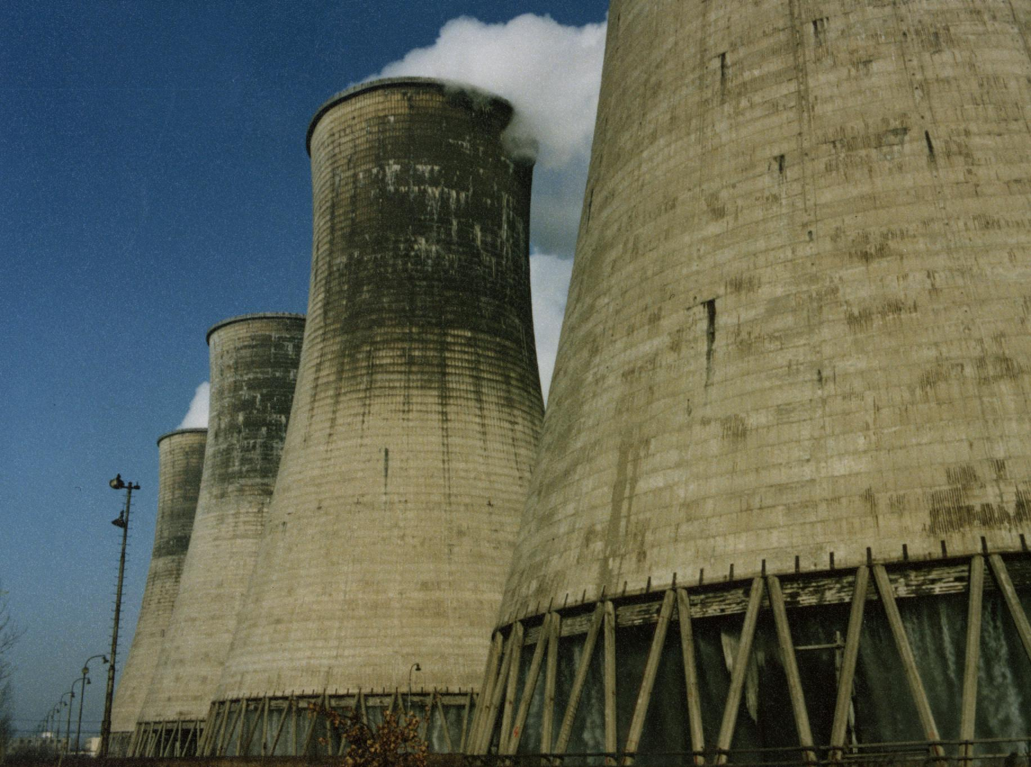
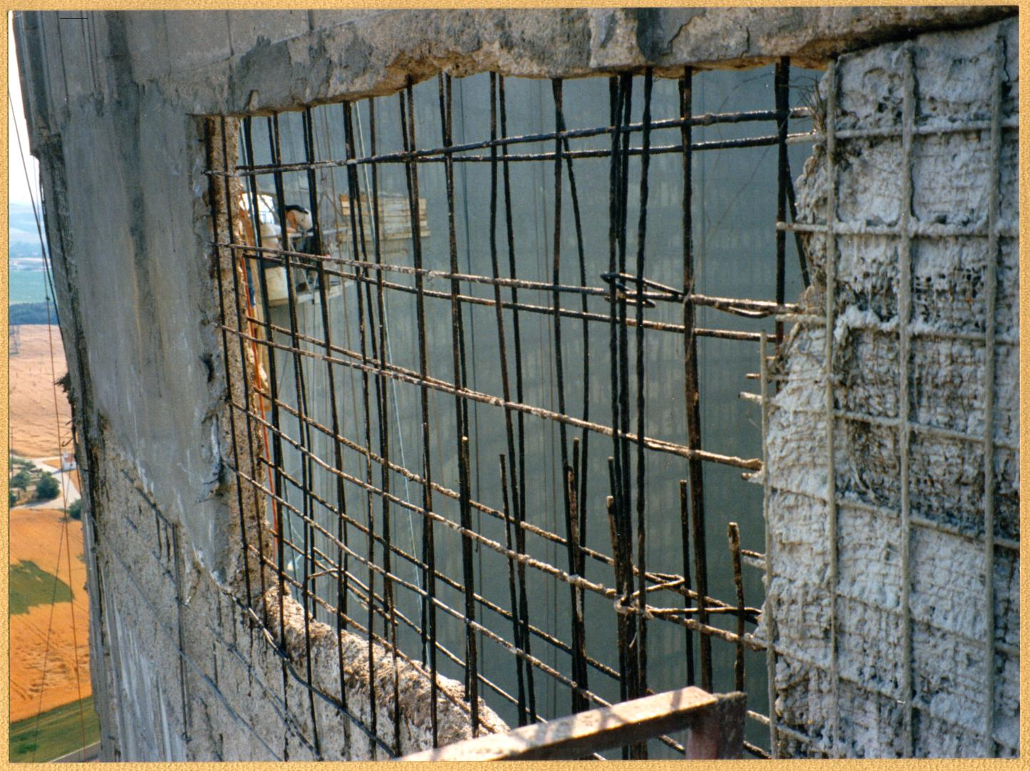
Cooling tower and its maintenance

Slide 3
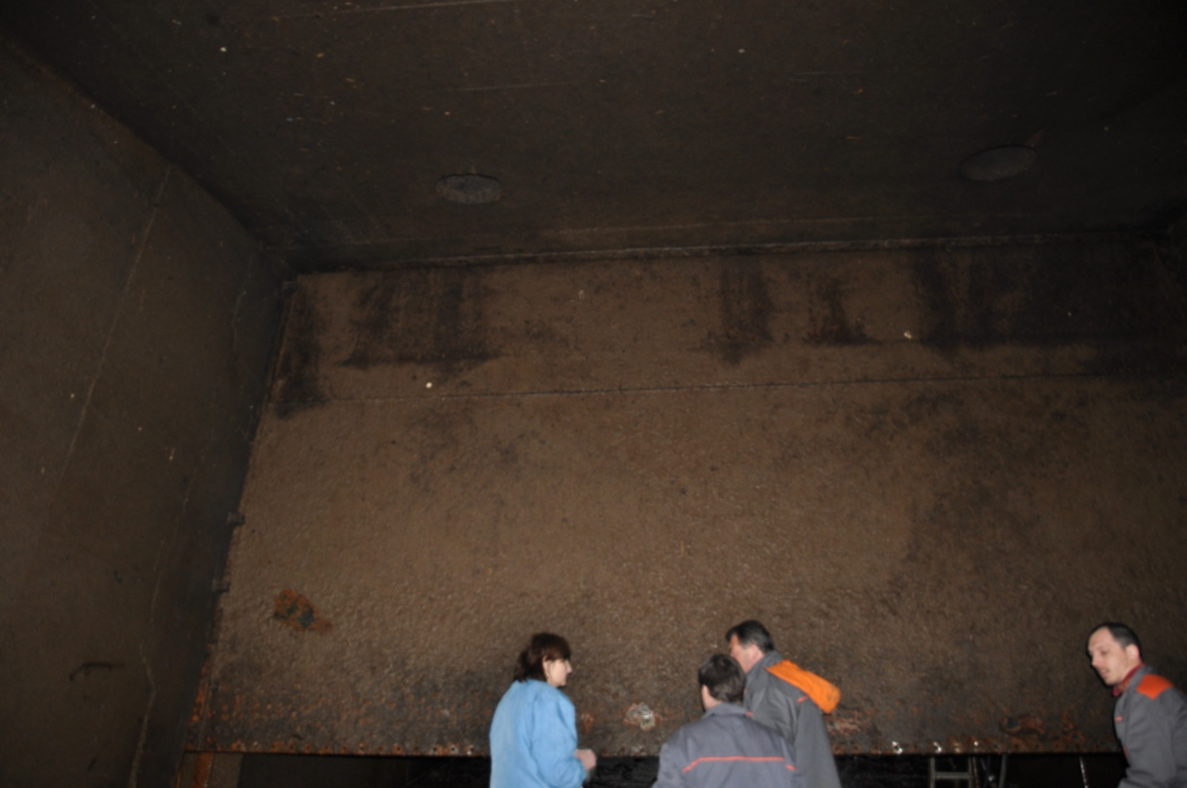
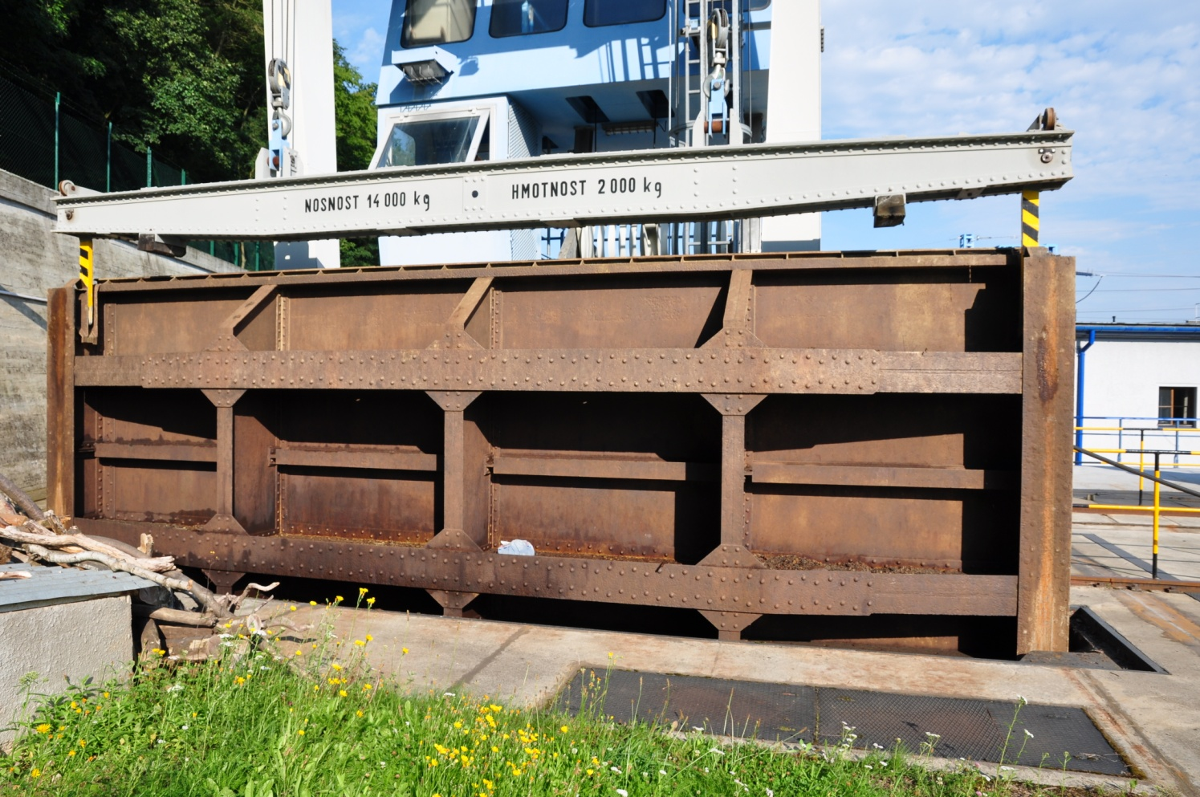
Steel retaining walls

Slide 4
Site measurements
Local distribution of a carbonation depth
spatial variation (environmental actions,
material properties)?
→ discretisation techniques
→ simplified approach based on “independent”
elementary surfaces

Slide 5
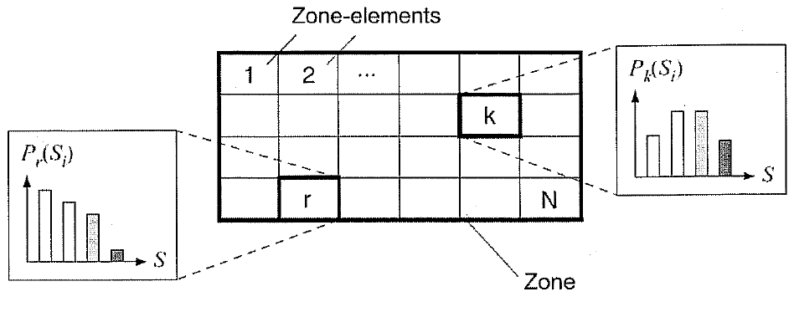
Simplified deterioration model
- division into zones (similar exposures – splash/upper parts of piers)
- within zones homogeneous random fields W (material properties, concrete cover) + hyperparameters X (single value for whole structure)
discretization of the zone into N elementary surfaces (random field variables independent)
fib Bulletin 59 Condition control and assessment of reinforced concrete structures

Slide 6
Simplified deterioration model
- For steel structures the size of an elementary surface may correspond to a size of inspected areas (e.g. 3 m)
- Concrete, chloride ingress ~ 0,5-2 m
P_{f}(t) = P{n_{deg}(t) / N ≥ α_{lim}}
= E_{X(t)}{1 - F_{binom}[Nα_{lim}, N, p_{f}(W|x(t))]}
FORM/
SORM
p_{f}(∙) is the failure probability of an elementary surface
The limiting deterioration level α_{lim} = 0,1-0,2
α_{lim} = 0,15 accepted in the example

Slide 7
Example – carbonation of concrete fib Model Code for Service Life Design
Measurements
no trend?
elementary surface: p_{f}(t,μ_{R}|k_{S},x) = P[R(μ_{R}) − k_{S} S(t,W|x) < 0]

Slide 8
Variation of P_{f}(t) with t μ_{R} = 25 mm, α_{lim} = 0.15

Slide 9
Probabilistic optimization of the concrete cover
The total cost
C_{tot} = C₀ + C₁ μ_{R} + E[C_{f}]
Expected consequences
Annual discount rate q

Slide 10
Variation of optimum reliability index β_{opt} with N q = 0.03, t = 40 years, and C_{f} / C₁ = 100 and 1 000

Slide 11
Conclusions
Structural durability may be affected by spatial variability particularly for large surfaces.
Presented model seems to require lower computational demands compared to random field techniques (to be proved by upcoming studies).
This model is expected to be an effective tool for optimisation studies.
Numerical example of concrete carbonation reveals that the failure probability somewhat increases with a size of surface.
The optimum concrete cover and reliability index can be considered independent of the size of the surface area.

Slide 12

Miroslav Sykora and Milan Holicky
miroslav.sykora@klok.cvut.cz
Durability Assessment of Large Surfaces
Using Standard Reliability Methods
Thank you for your attention.

Slide 13
Concrete Cover
(cooling tower EDUV5)

